Slide 1
IMDB Movie Analysis
Submitted by Nalina Lingasamy DTM10

Slide 2
Problem statement
The IMDB Movie Analysis Project aims to explore the factors influencing the success of movies on IMDB, focusing on their ratings.
By analysing a dataset containing information about various movies, the project seeks to provide insights that can guide stakeholders in the film industry in making informed decisions for future projects.

Slide 3
Data cleaning and Pre-processing
Dataset was loaded in Jupyter notebook.
Null values and datatypes where checked for all columns in the dataset.
For various numerical columns in the data, distribution plot was made by importing seaborn library.
If the distribution was normal, null values were replaced with mean of the particular column. If it is not normal, null values were replaced with median of the particular column.
For columns like Actor’s name, Director’s name, null values were filled with “Not specified” string.

Slide 4
Data cleaning and Pre-processing
Some of the column’s null values were filled with mode of the particular column.
The column “genres” contains many categories separated by “|”. It was splitted using string split method and splitted categories were exploded into separate rows.
The genres list was further grouped based on IMBD score and its mean, median, mode, max, min, standard deviation, variance was calculated.
The treated data frame was then saved as an excel file and loaded into PowerBI.

Slide 5
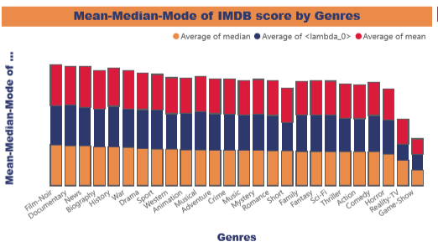
Data Analysis - Movie Genre Analysis
At 7.65, Film-Noir had the highest Average of median and was 163.79% higher than Game-Show, which had the lowest Average of median at 2.90. ﻿
﻿Average of median and total Average of mode are positively correlated with each other.
Across all 26 genres list, Average of median ranged from 2.90 to 7.65, Average of mode ranged from 2.90 to 7.50, and Average of mean ranged from 2.90 to 7.63. ﻿

Slide 6
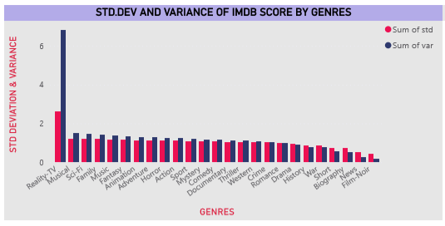
Data Analysis - Movie Genre Analysis
At 2.62, Reality-TV had the highest Sum of std and was 505.55% higher than Film-Noir, which had the lowest Sum of std at 0.43. ﻿﻿ ﻿﻿ ﻿﻿
Sum of std and total Sum of var are positively correlated with each other. ﻿﻿ ﻿﻿
﻿﻿Reality-TV accounted for 9.80% of Sum of std.﻿﻿ ﻿﻿ ﻿﻿
Sum of var and Sum of std diverged the most when the genres_list was Reality-TV, when Sum of var were 4.23 higher than Sum of std.﻿﻿

Slide 7
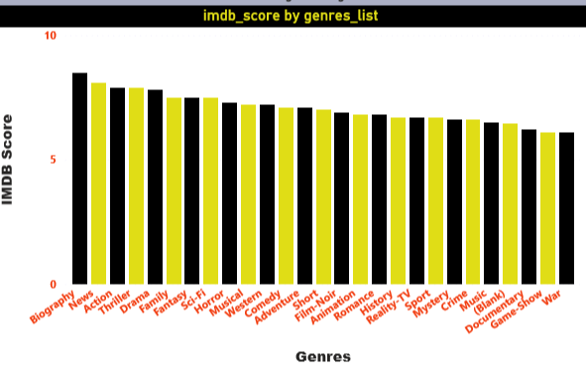
Data Analysis - Movie Genre Analysis
Average of imdb_score was highest for Biography at 8.50, followed by News and Action. ﻿﻿ ﻿﻿
Across all 27 genres_list, Average of imdb_score ranged from 6.10 to 8.50. ﻿﻿ ﻿﻿ ﻿

Slide 8
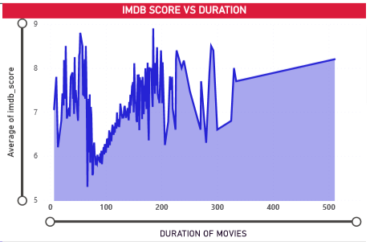
Movie Duration Analysis
At 8.90, 185 had the highest Average of imdb_score and was 67.92% higher than 67, which had the lowest Average of imdb_score at 5.30.
﻿﻿﻿185 had the highest Average of imdb_score at 8.90, followed by 54 and 55. 67 had the lowest Average of imdb_score at 5.30.﻿﻿ ﻿﻿
﻿﻿Across all 192 duration, Average of imdb_score ranged from 5.30 to 8.90.﻿﻿

Slide 9
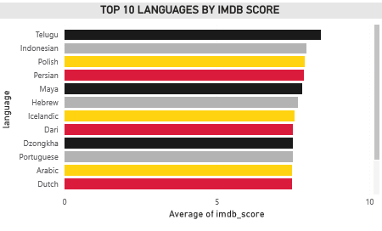
Language Analysis
Average of imdb_score was highest for Telugu at 8.40, followed by Indonesian and Polish. ﻿﻿
﻿﻿﻿﻿Across all 15 language, Average of imdb_score ranged from 7.40 to 8.40

Slide 10
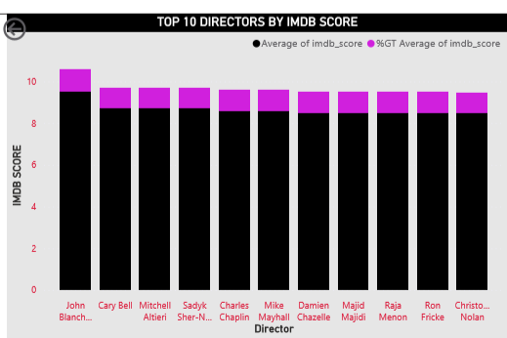
Director Analysis
The top 10 directors were shown based on IMDB score.
The top most director is John Blanch with an average score of 9.50 followed by Cary Bell, Mitchell Alteri and Sadyk Sher-N with an average score of 8.70.
Charles Chaplin and Mike Mayhall holds the third position with an average score of 8.60.

Slide 11
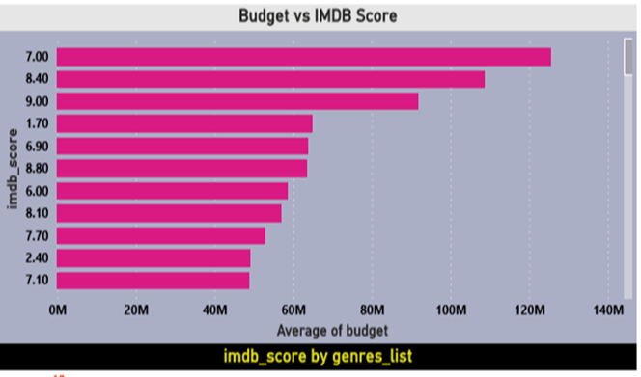
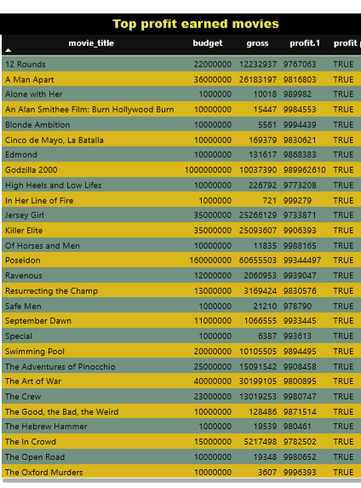
Budget Analysis
At 12,56,80,222.98, 7 had the highest Average of budget and was 6,030.74% higher than 2.60, which had the lowest Average of budget at 20,50,000.00.﻿﻿
﻿﻿﻿﻿Across all 78 imdb_score, Average of budget ranged from 20,50,000.00 to 12,56,80,222.98.﻿﻿ ﻿﻿ ﻿

Slide 12
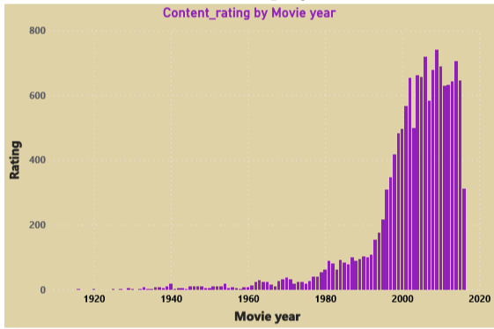
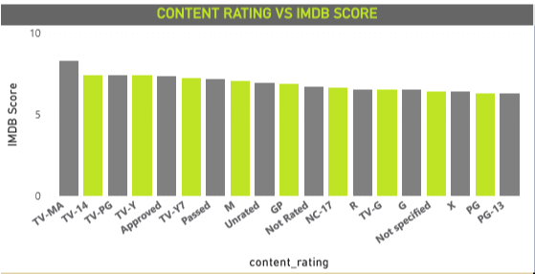
Rating analysis
Count of content_rating was highest for 2009 at 740, followed by 2006 and 2014.﻿﻿ ﻿﻿ ﻿﻿2009 accounted for 5.10% of Count of content_rating.﻿﻿ ﻿﻿
﻿﻿Across all 91 title_year, Count of content_rating ranged from 2 to 740.﻿﻿ ﻿﻿ ﻿
At 8.30, TV-MA had the highest Average of imdb_score and was 32.50% higher than PG-13, which had the lowest Average of imdb_score at 6.27.﻿﻿
﻿﻿﻿﻿Across all 19 content_rating, Average of imdb_score ranged from 6.27 to 8.30.﻿﻿ ﻿﻿ ﻿

Slide 13
Summary of IMDB Movie Analysis
Content Rating Analysis:
TV-MA content rating had the highest average IMDB score, significantly higher than PG-13.
Content ratings varied widely in terms of IMDB score, with 2009 having the highest count of content rating.
Budget Analysis:
Movies with a budget of 7 had the highest average budget, followed by a substantial margin compared to the lowest average budget of 2.60.
Budgets ranged from 20,50,000.00 to 12,56,80,222.98 across all movies.

Slide 14
Summary of IMDB Movie Analysis
Director Analysis:
Top directors were identified based on their average IMDB scores, with John Blanch leading the list.
Directors play a significant role in determining movie success, as reflected in the IMDB scores of their movies.
Language Analysis:
Telugu emerged as the language with the highest average IMDB score, indicating its popularity among viewers.
Languages vary in terms of their impact on movie ratings, suggesting potential opportunities for language-specific film production.

Slide 15
Summary of IMDB Movie Analysis
Duration and Genre Analysis:
Movies with a duration of 185 minutes had the highest average IMDB score, indicating potential viewer preference for longer films.
Biography genre had the highest average IMDB score, followed by News and Action, suggesting audience interest in these genres.

Slide 16
Implications for Stakeholders
Producers, directors, and investors can leverage insights from content ratings, budgets, directors, languages, durations, and genres to make informed decisions about future movie projects.
Understanding the preferences of target audiences based on content ratings, languages, and genres can help in developing more appealing and successful movies.

Slide 17
Recommendations for Future Analysis
Further exploration of the relationship between specific genres, directors, and audience demographics could provide deeper insights into movie success factors.
Conducting sentiment analysis on viewer reviews and social media mentions could supplement IMDB scores to provide a more comprehensive understanding of movie reception.
Investigating the impact of marketing strategies, release timing, and competition within the film industry could offer additional insights into movie success determinants.
By leveraging these insights and recommendations, stakeholders in the film industry can enhance their decision-making processes and increase the likelihood of producing successful movies that resonate with audiences.

